Slide 1
Lecture 8 MDC,MAC,NMAC,HMAC,CMAC From Cryptography and network security by Forouzan and Mukhopadhyay 2nd edition Arti Deshpande TSEC

Slide 2
Message Authentication
A message digest guarantees the integrity of a message.
It guarantees that the message has not been changed.
A message digest however does not authenticate the sender of the message.
When Alice sends a message to Bob, Bob needs to know if the message is coming from Alice.
To provide message authentication, Alice needs to provide proof that it is Alice sending the message and not an imposter.
What is needed is a message authentication code…

Slide 3
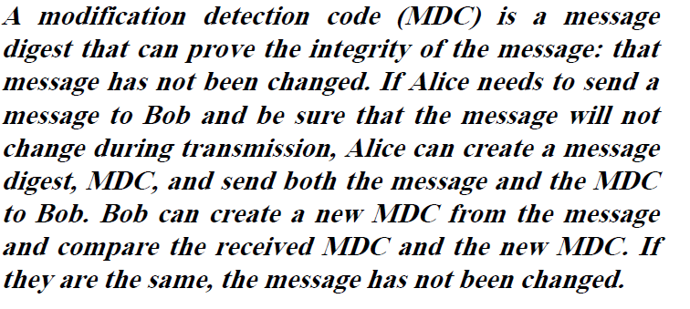
MDC(Modification detection Code)

Slide 4
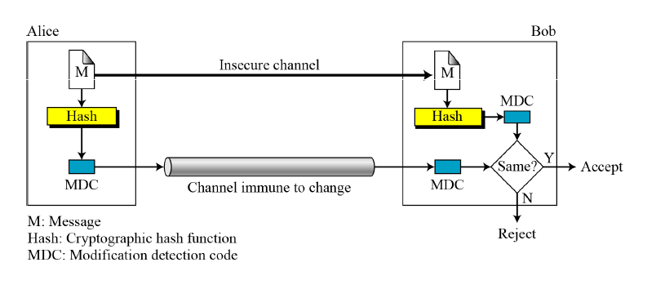
MDC

Slide 5
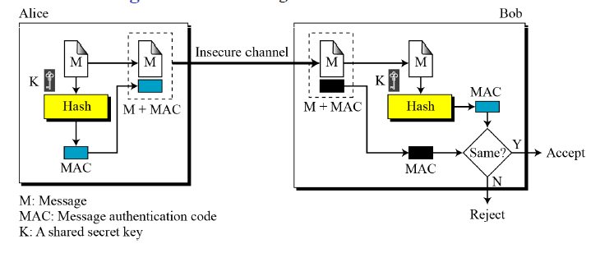
MAC(Message authentication Code)
To provide integrity and message authentication-we need an MAC.
MAC includes secret key between Alice and Bob, a key that Eve does not possess.

Slide 6
Alice uses a hash function to create a MAC from the concatenation of the key and the message, h(K|M).
She sends the message and the MAC to Bob.
Bob separates the message from the MAC.
He then makes a new MAC from the concatenation of the message and the secret key.
Bob then compares the newly created MAC with received one.
If the 2 MACs match. The message is authentic and has not been modified.

Slide 7
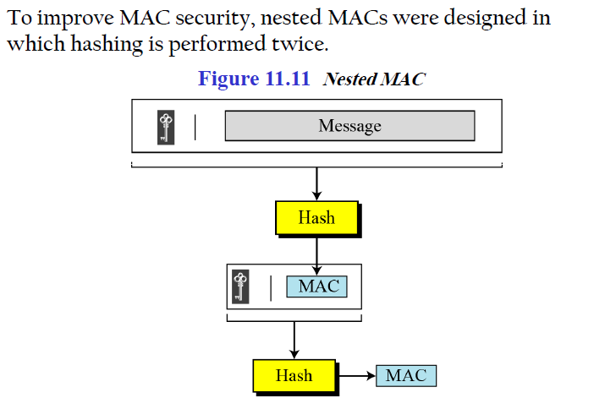
Nested Macs

Slide 8
Nested MAC
In the first step ,the key is concatenated with the message and is hashed to create an intermediate digest.
In the second step, the key is concatenated with the intermediate digest to create the final digest.

Slide 9
HMAC
NIST (National Institute of Standards and Technology) has issued a standard (FIPS198) for a nested MAC
that is referred to as HMAC (hashed MAC).
The message is divided into N blocks, each of b bits.
The secret key is left-padded with 0’s to create a b-bit key. Note that it is recommended that secret key (before padding) be longer than n bits, where n is the size of the HMAC.
The result of step 2 is XORed with a constant called ipad (input pad) to create a b-bit block. The value of ipad is the b/8 repetition of the sequence 00110110 ((36)₁₆).

Slide 10
HMAC
4. The resulting block is prepended to N-block message.
The result is N+1 blocks.
5. The result of step 4 is hashed to create an n-bit digest. We call the digest the intermediate HMAC.
6. The intermediate n-bit HMAC is left padded with 0s to make a b-bit block.
7. Step 2 and 3 are repeated by a different constant opad (output pad). The value of opad is the b/8 repetition of the sequence 01011100 ((5C)₁₆).
8. The result of step 7 is prepended to the block of step
9. The result of step 8 is hashed with the same hashing
algorithm to create the final n-bit HMAC.

Slide 11
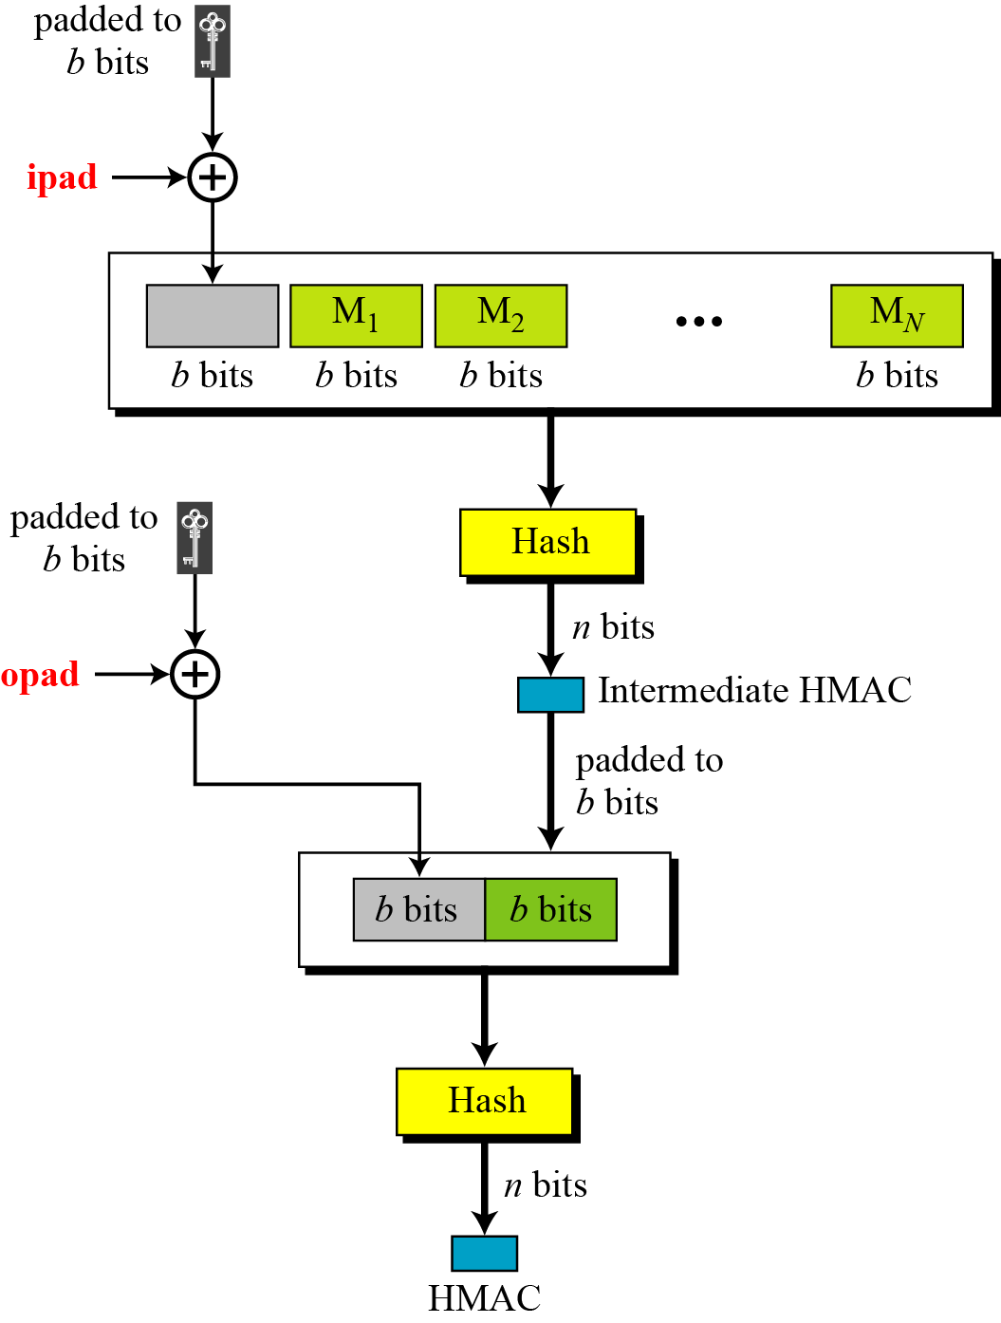
HMAC (Continued)
Details of HMAC

Slide 12
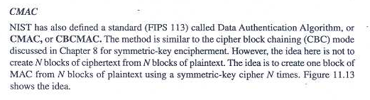
CMAC

Slide 13
